Slide 1
IT301 Midsem Project Report
Parallelization of the Harris Corner Detector
By: Viren Varma 191ME293
Rahul Maheshwari 191CH039
Shreyas Rao 191EE224

Slide 2
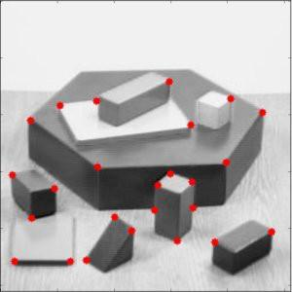
Detecting features (such as edges, corners etc) from images is an important preprocessing step in most computer vision applications. Our goal is to reliably detect corners in an image.
Objectives:
Some of the operations involved in the algorithms are matrix multiplication, convolution and for loops.

Slide 3
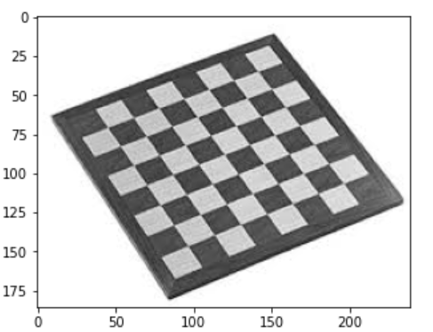
Sample Image

Slide 4
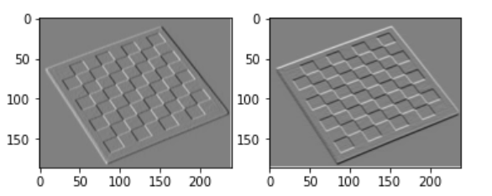
Algorithm:
Step 1: Perform convolution with Sobel filters

Slide 5
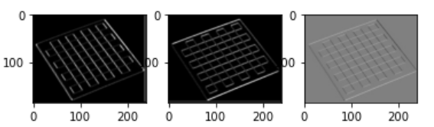
Step 2: Generate three images Ix2,Iy2 and Ixy in following way. Ix2 and Iy2 are the element wise square of matrices Ix and Iy respectively. Ixy is the element wise product of matrices Ix and Iy.

Slide 6
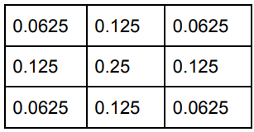
Step 3: Apply gaussian kernel to all the three images. Gaussian kernel is shown below. Let’s call the output matrices Jx2,Jy2 and Jxy.

Slide 7


Step 4: After applying gaussian kernel, for each pixel [i,j] in the image design a 2x2 matrix M whose entries are given as shown
Step 5: Compute the following parameter

Slide 8
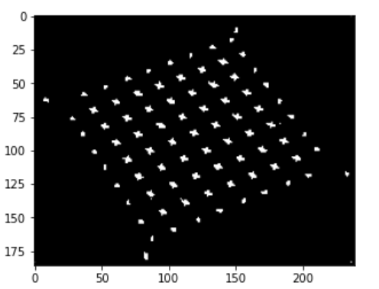
Step 7: Generate a binary image by comparing R value for each pixel with a threshold. If R is greater than threshold, assign 1 to the corresponding pixel and 0 otherwise

Slide 9
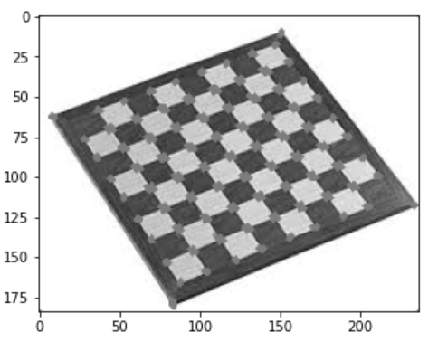
Final Output:

Slide 10
Thank you

